Slide 1
Group 387: Finding the best classifier to predict credit card fraud detection
Group member:
Vikas Sanil – vsanil1@hawk.iit.edu

Slide 2
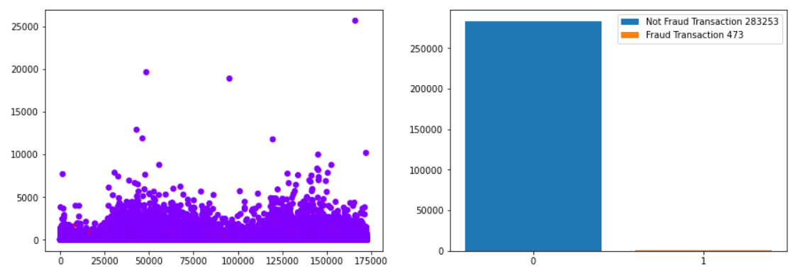
Dataset before data preprocessing:

Slide 3
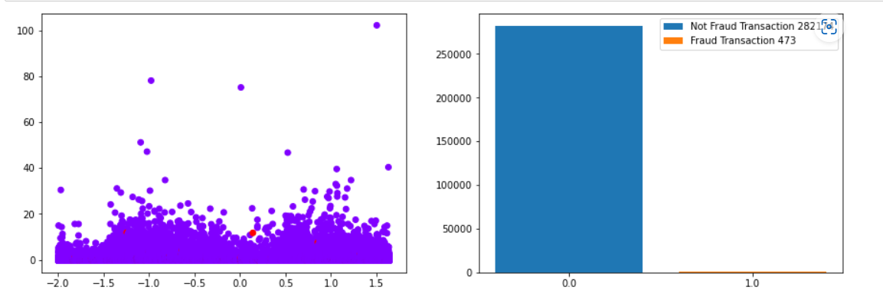
Data after duplicate removal and standardization:

Slide 4
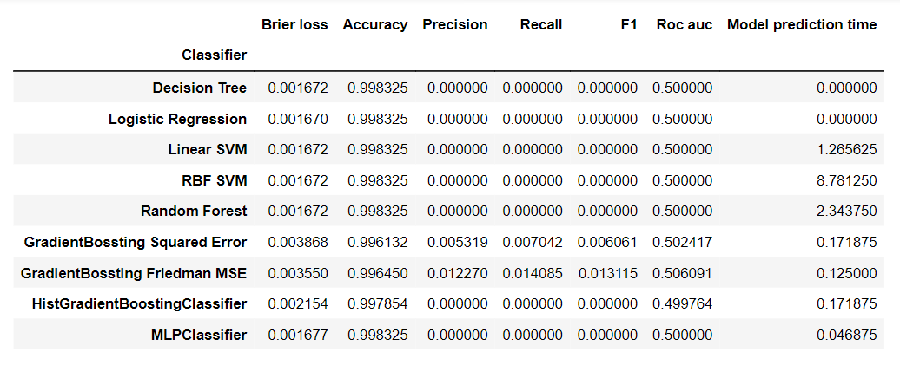
Results on imbalanced dataset with minority positive cases:

Slide 5
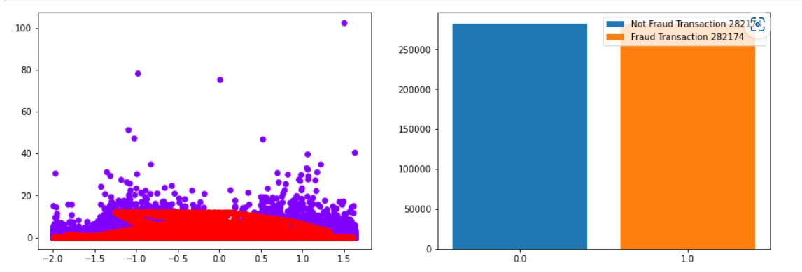
Data after over sampling minority cases using SMOTE:

